Slide 1
PART 5
CONSTRAINTS

Slide 2
Constraints are used to specify rules for data in a table. This ensures the accuracy and reliability of the data in the table.
Constraints can be specified when the table is created with the CREATE TABLE statement, or after the table is created with the ALTER TABLE statement.
There are two types of constraints—
Regular Constraints | Key Constraints
Null By setting NOT NULL to the col, no null value will be accepted, value will be mandatory to enter | Unique Value that is not duplicated but can have only one null value
2. Default If the col contains only one value throughout the table, you can set the value as default value so it gets automatically entered. | 2. Primary key (Parent value) The primary key can be used to uniquely identify the rows of a table. Only one primary key is allowed per table. No duplicates / null values
Check It works based on given condition for specific column | 3. Foreign key (child value) Foreign Keys constraints ensure data integrity, by enforcing that values in one table must match values in another table.

Slide 3
Normalization
The process of splitting one big table in multiple small tables is called normalization.
The purpose of normalization is
To save storage
To make application work smoother and faster
To increase performance
To decrease data ETL process

Slide 4
Before Normalization
SID | NAME | AGE | CID | CNAME | AMOUNT
1 | Ram | 21 | 1 | SQL | 15000
2 | John | 22 | 1 | SQL | 15000
3 | Sana | 23 | 2 | Power-BI | 12000
Studentsdetails
Table
After Normalization
CID | CNAME | AMOUNT
1 | SQL | 15000
2 | Power-BI | 12000
Coursedetails
Table
SID | NAME | AGE | CID
1 | Ram | 21 | 1
2 | John | 22 | 1
3 | Sana | 23 | 2
Studentsdetails
Table

Slide 5
Practical Implementation

Slide 6
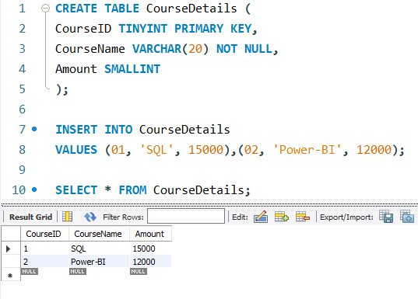

Slide 7
